Slide 1
Simple spread models for conifer surface fires

Slide 2
Abstract
Surface fire behaviour is the most frequent type of wildfire activity that occurs in conifer forests.
Surface rate of spread (ROS) models can provide guidance under conditions less conducive to crown fire: low to moderate fire danger conditions or in forest stands with a high crown base.
We used a database of conifer-dominated experimental surface fires to fit simple empirical models of ROS under light-to-dense canopy stands that can be readily integrated within operational decision support systems.
Final models are based on the Canadian Initial Spread Index (ISI) or stand-adjusted ISI (ISI_{SA}), with options for other predictors such as estimated surface fuel consumption (SFC) or fuel type.
The simplest model finds surface ROS equal to 1.5 % of open 10 m wind speed.
While imprecise, these models are usually accurate enough (within +/- 2–4 m min⁻¹) for many forecasting and fire management purposes.

Slide 3
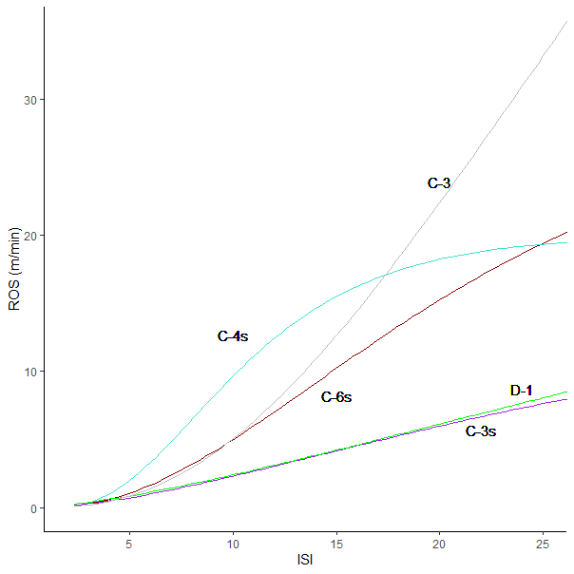
Original FBP-era sROS models:
D-1,
C-6s,
C-3s (CEVW 93),
C-4s (CEVW 93)
C-3 shown for comparison

Slide 4
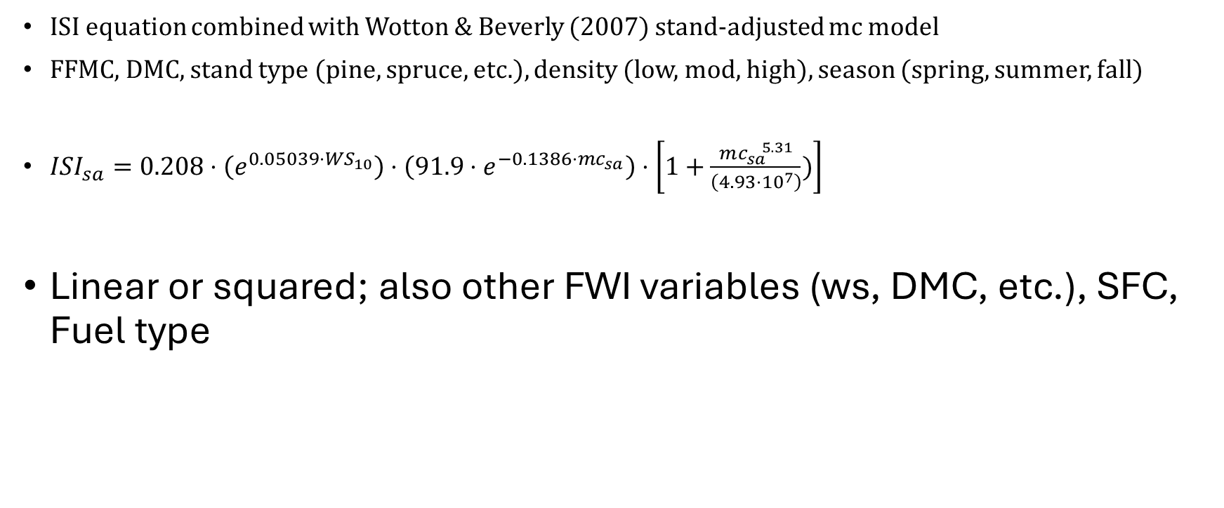
ISI and ISI_{sa}
ISI equation combined with Wotton & Beverly (2007) stand-adjusted mc model
FFMC, DMC, stand type (pine, spruce, etc.), density (low, mod, high), season (spring, summer, fall)
$ISI_{sa}=0.208⋅\left(e^{0.05039⋅WS_{10}}\right)⋅\left(91.9⋅e^{−0.1386⋅mc_{sa}}\right)⋅\left[1+\frac{mc_{sa}^{ 5.31}}{\left(4.93⋅{10}^{7}\right)})\right]$
Linear or squared; also other FWI variables (ws, DMC, etc.), SFC, Fuel type

Slide 5
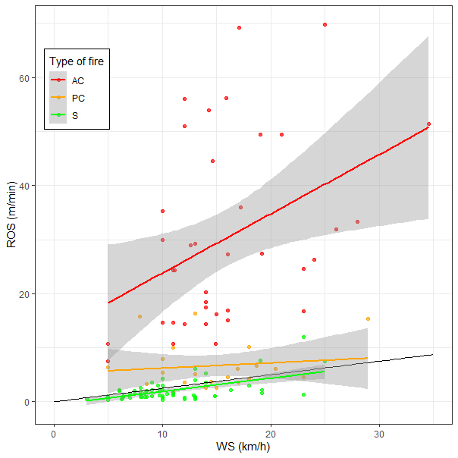

Slide 6
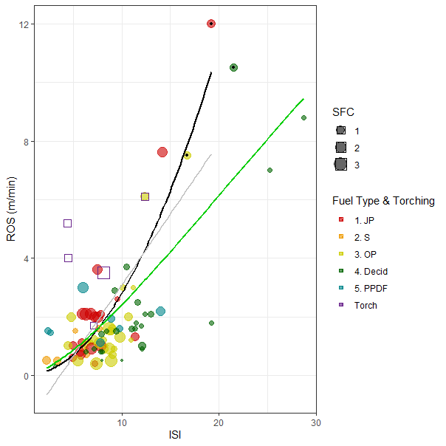

Slide 8
SFC and FT models

Slide 9
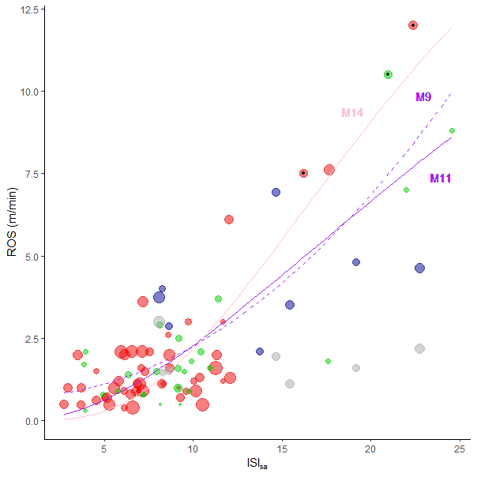

Slide 10
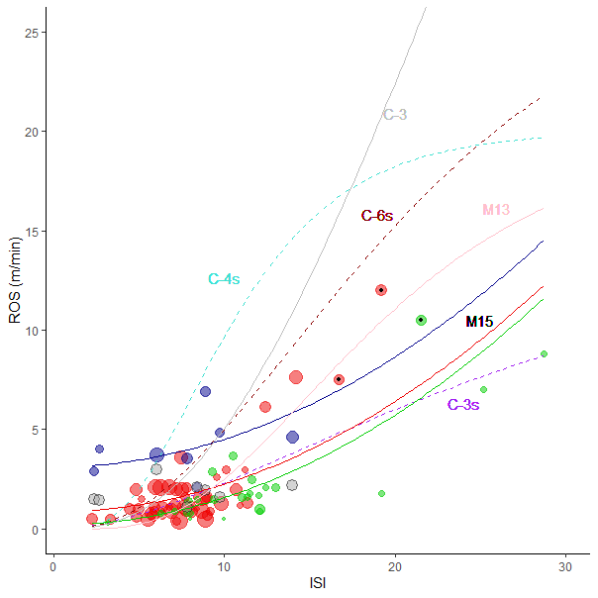

Slide 11
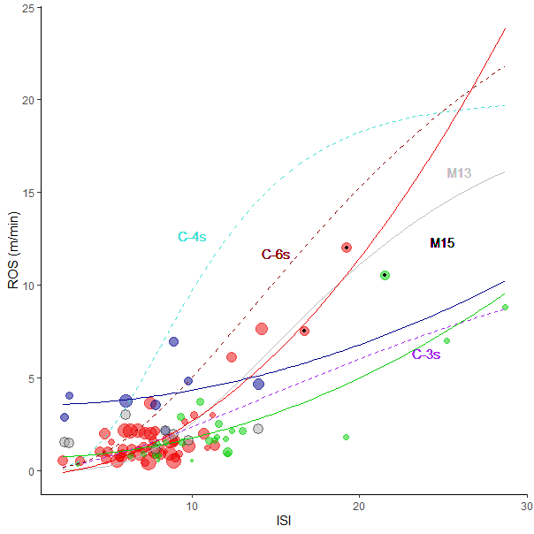

Slide 12
M9: Under- and Over-prediction
Overprediction, ISI > 12: mean of 1.7 m/min
Underprediction, ISI > 12: mean of 3.0 m/min
Overprediction, ISI < 12: mean of 0.6 m/min
Underprediction, ISI < 12: mean of 0.8 m/min

